Slide 1


React JS
(the usecontext() hook)
Lecture-34

Slide 2
Today’s Agenda
Introduction To Context API In React
The useContext() Hook
Steps Needed To Use Context API
Example

Slide 3
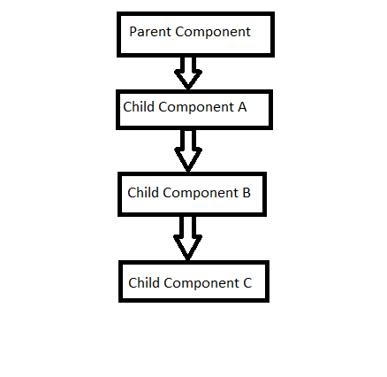
What Is Context In React ?
In React, suppose we have a Parent component having 3 levels of child components

Slide 4
What Is Context In React ?
Now if we want to pass any data from Parent component to Child component C, so as per React we need to pass props to each level to be available to Child component C.
This solution might not be feasible when we have too many levels of nesting of child components .

Slide 5
What Is Context In React ?
So, React provides us a concept call Context API.
React Context API allows us to easily access data at different levels of the component tree, without passing prop to every level.
In Hooks , we achieve this using useContext() hook

Slide 6
Using Context API
To use the Context API we need to take 5 steps:
Create a context object in Parent component
Add the state value to the context object
Export the context object
Import the context object in Child component
Access the context data in Child component

Slide 7
Creating The Context Object
To start with the Context API, the first thing we need to do is create a context using the createContext() function from React.
Example:
const EmpContext = React.createContext();

Slide 8
Creating The Context Object
The createContext() function returns a context object .
We can also pass it some initial value, but this initial value is optional.
After creating our context, that context now has two React components that are going to be used: Provider and Consumer

Slide 9
The Provider Component
The Provider component is used to wrap the components that are going to have access to our context.
Example
<EmpContext.Provider value={some_value}>
...
</ EmpContext.Provider >

Slide 10
The Provider Component
The Provider component receives a prop called value, which can be accessed from all the components that are wrapped inside Provider, and it will be responsible to grant access to the context data

Slide 11
The Consumer Component
The Consumer component allows us to access the context data stored inside a context object.
Example
<EmpContext.Consumer>
{(value) => <h1>{value}</h1>}
</EmpContext.Consumer>

Slide 12
The Consumer Component
It requires a function as a child.
The function receives the current context value and returns a React node.
The argument passed to the function will be equal to the value prop of the Provider.

Slide 13
Exercise 1
Create Three Functional Component called Parent ,Child and SubChild.
The Parent component should have employee data in state with id,name and sal attributes.
But this data should be shown by SubChild component which is nested inside the Child Component.

Slide 14
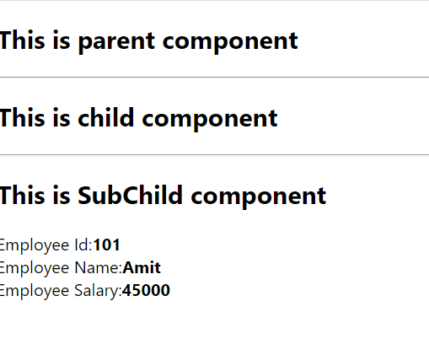
Desired Output

Slide 15
Solution
Parent.js
import React, { useState } from "react";
import Child from "./Child";
export let EmpContext = React.createContext();
function Parent() {
const [emp, setEmp] = useState({ id: 101, name: "Amit", sal: 45000 });
return (
<div>
<h2>This is parent component</h2>
<hr />
<EmpContext.Provider value={emp}>
<Child />
</EmpContext.Provider>
</div>
);
}
export default Parent;

Slide 16
Solution
Child.js
import React from "react";
import SubChild from "./SubChild";
function Child() {
return (
<>
<h2>This is child component</h2>
<hr />
<SubChild />
</>
);
}
export default Child;

Slide 17
Solution
SubChild.js
import React from "react";
import { EmpContext } from "./Parent";
function SubChild() {
return (
<>
<h2>This is SubChild component</h2>
<EmpContext.Consumer>
{(emp) => {
return (
<>
Employee Id:<b>{emp.id}</b>
<br />
Employee Name:<b>{emp.name}</b>
<br />
Employee Salary:<b>{emp.sal}</b>
</>
);
}}
</EmpContext.Consumer>
</>
);
}
export default SubChild;

Slide 18
Problem With The SubChild
Look at how we read the value inside the SubChild component we have to wrap our content in a EmpContext.Consumer and use the render props pattern – passing a function as a child – to retrieve the value and display it.
This works fine, and “render props” can be a great pattern for passing dynamic data around, but it does introduce some extra nesting, overhead and it just looks a bit weird

Slide 19
So What’s The Solution ?
So the next obvious question is how to simplify the code in SubChild component
The answer is , by using useConetxt() — the hook that allows us to access the context data in a much simpler way

Slide 20
The useContext() Hook
The useContext() hook allows us to connect and consume a context.
The useContext() hook receives a single argument, which is the context that we want to have access to.

Slide 21
The useContext() Hook
Example:
const emp = useContext(EmpContext);
The useContext() is way better and cleaner than the Consumer component—we can easily understand what’s going on and increase the maintainability of our application.

Slide 22
Improved Version Of SubChild
import React, { useContext } from "react";
import { EmpContext } from "./Parent";
function SubChild() {
let emp = useContext(EmpContext);
return (
<>
<h2>This is SubChild-2 component</h2>
Employee Id:<b>{emp.id}</b>
<br />
Employee Name:<b>{emp.name}</b>
<br />
Employee Salary:<b>{emp.sal}</b>
<br />
</>
);
}
export default SubChild;

Slide 23
Updating The Context Object
The React Context API is stateless by default and doesn't provide a dedicated method to update the context value from consumer components.
But this can be easily implemented by integrating a state management mechanism like useState(), and providing an update function right in the context next to the value itself.

Slide 24
Exercise 2
Modify the previous App by making following changes:
Display complete emp data in Child as well as SubChild components and only salary in Parent component.
Provide a button in SubChild component to increment salary by 10%

Slide 25
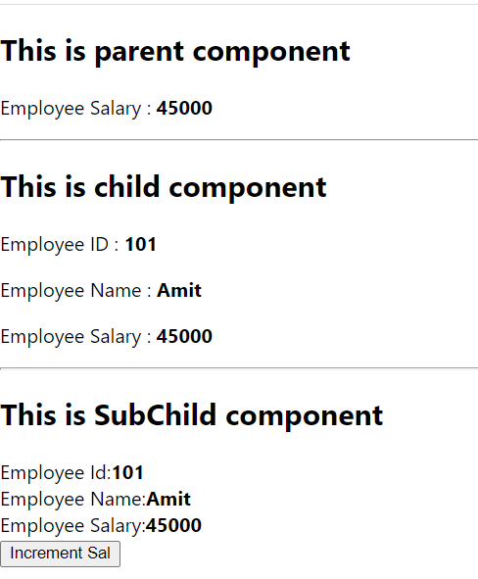
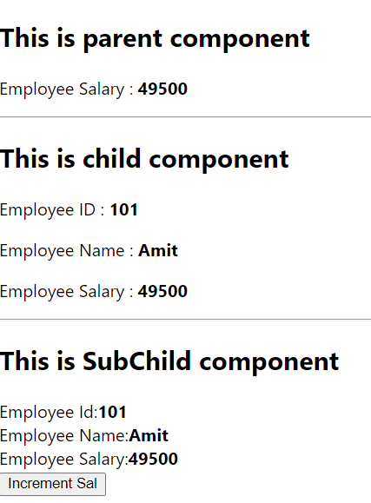
Desired Output
Before Click
After Click

Slide 26
Desired Output

Slide 27
Solution
Parent.js
import React, { useState } from "react";
import Child from "./Child";
export let EmpContext = React.createContext();
function Parent() {
const [emp, setEmp] = useState({ id: 101, name: "Amit", sal: 45000 });
return (
<div>
<h2>This is parent component</h2>
<p>
<label>
Employee Salary : <b>{emp.sal}</b>
</label>
</p>
<hr />
<EmpContext.Provider value={{ data: emp, updateEmp: setEmp }}>
<Child />
</EmpContext.Provider>
</div>
);
}
export default Parent;

Slide 28
Solution
Child.js
import React, { useContext } from "react";
import { EmpContext } from "./Parent";
import SubChild from "./SubChild";
function Child() {
let context = useContext(EmpContext);
return (
<>
<h2>This is child component</h2>
<p>
<label>
Employee ID : <b>{context.data.id}</b>
</label>
</p>
<p>
<label>
Employee Name : <b>{context.data.name}</b>
</label>
</p>

Slide 29
Solution
Child.js
<p>
<label>
Employee Salary : <b>{context.data.sal}</b>
</label>
</p>
<hr />
<SubChild />
</>
);
}
export default Child;

Slide 30
Solution
SubChild.js
import React, { useContext } from "react";
import { EmpContext } from "./Parent";
function SubChild() {
let context = useContext(EmpContext);
function updateSalary() {
let newSal = context.data.sal + context.data.sal * 0.1;
context.updateEmp({ ...context.data, sal: newSal });
}
return (
<>
<h2>This is SubChild component</h2>
Employee Id:<b>{context.data.id}</b>
<br />
Employee Name:<b>{context.data.name}</b>
<br />
Employee Salary:<b>{context.data.sal}</b>
<br />
<button onClick={updateSalary}>Increment Sal</button>
</>
);
}
export default SubChild;

